Slide 1
CULINARY TRADITIONS & HERITAGE
Flavors of Azerbaijan: A Cultural Journey
Discover the rich history, vibrant spices, and timeless hospitality of Azerbaijani national cuisine.

Slide 2



INTRODUCTION
The Art of Azerbaijani Cuisine
Fresh Regional Herbs
Saffron & Silk Road Spices
Slow Cooking Tradition
Tarragon, cilantro, basil, and mint elevate every authentic national dish.
Golden saffron and sumac deliver distinct aroma and vibrant color.
Clay pot stews and open fire charcoal grills preserve deep flavor.

Slide 3
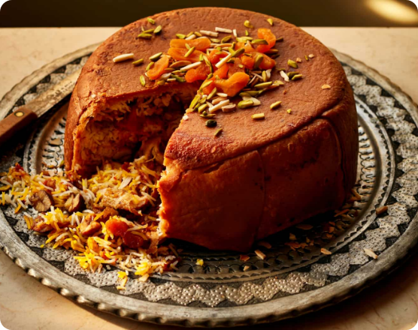
NATIONAL DISH
Plov: The Crown Jewel
Shah Plov (King's Pilaf)
Baked inside a golden lavash dough crown with saffron rice.
Signature Ingredients
Tender lamb, chestnuts, dried plums, and golden raisins.
Over 40 unique regional variations across Azerbaijan.

Slide 4
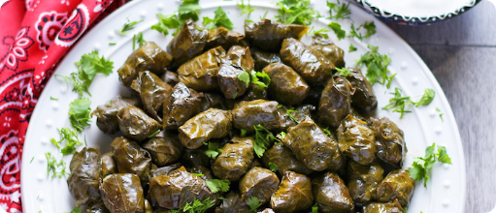
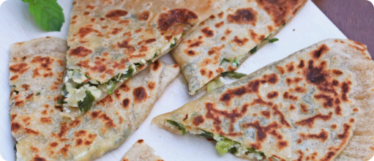
POPULAR STAPLES
Dolma & Qutab
Yarpaq Dolmasi
Crispy Qutab
Minced lamb wrapped in tender grape leaves, served with garlic yogurt.
Paper-thin flatbread stuffed with fresh green herbs, pumpkin, or minced meat.

Slide 5
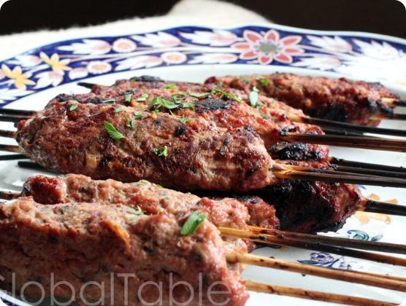
MEAT SPECIALTIES
Lyulya Kebab & Sheki Piti
Lyulya Kebab
Minced lamb grilled over open charcoal embers, dusted with sumac.
Sheki Piti
Eight-hour slow-cooked stew in individual clay pots with chickpeas and chestnuts.

Slide 6
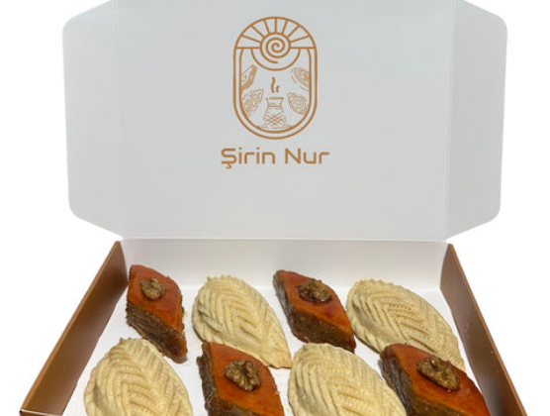
DESSERTS & PASTRIES
Sweet Festive Delights
Pakhlava (Baklava)
Layered thin pastry with finely crushed walnuts, cardamom, and saffron honey syrup.
Şəkərbura (Shekerbura)
Crescent-shaped pastry with carved wheat patterns, filled with hazelnut and sugar.
Essential festive treats during Novruz spring celebrations.

Slide 7
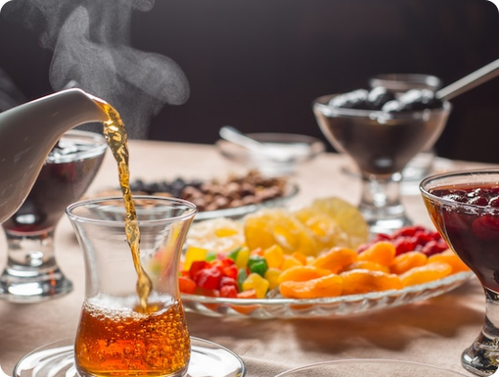
HOSPITALITY SYMBOL
Armudu Tea Culture
Pear-Shaped Armudu Glass
Keeps tea hot at the bottom while cooling at the top rim.
Traditional Tea Accompaniments
Served with wild cherry, quince, and walnut preserves.
Recognized as UNESCO Intangible Cultural Heritage.

Slide 8
THANK YOU
Nuş Olsun! (Bon Appétit!)
Questions or thoughts on Azerbaijani culinary culture?

